Slide 1
EXPERIMENT 7 :
Static Routing Analysis using Packet Tracer
ALGORITHM:
Step 1. The source node transmits the frames continuously.
Step 2. Each frame in the buffer has a sequence number starting from 1 and increasing up to the window size.
Step 3. The source node has a window i.e. a buffer to store the frames. This buffer size is the number of frames to be transmitted continuously.
Step 4. The receiver has a buffer to store the received frames. The size of the buffer depends upon the window size defined by the protocol designer.
Step 5. The size of the window depends according to the protocol designer.
Step 6. The source node transmits frames continuously till the window size is exhausted. If any of the frames are received with error only those frames are requested for retransmission
Step 7. If all the frames are received without error, a cumulative positive acknowledgement is sent.

Slide 2
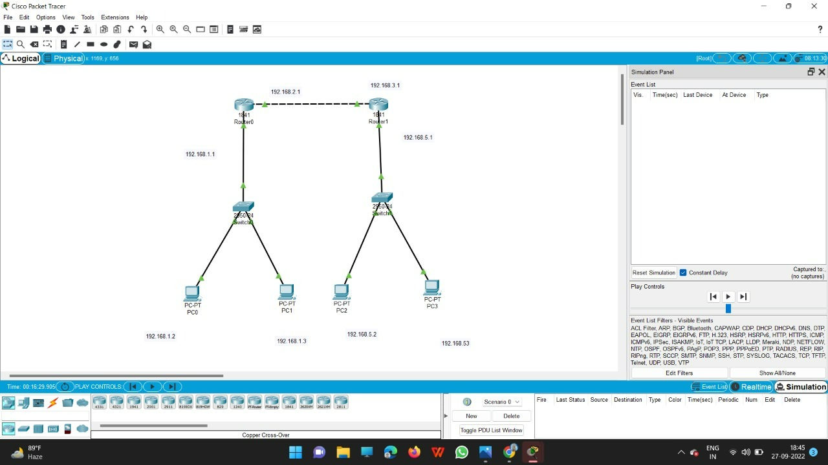
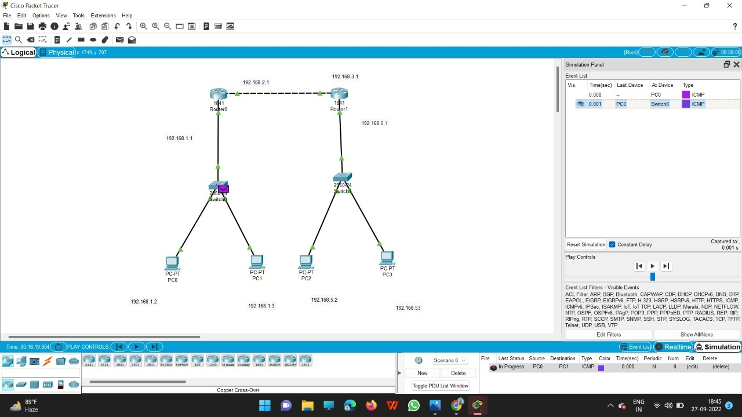

Slide 3
